Slide 1
Insurance Fraud Detection Using Machine Learning by Allen Sachin Vedantha

Slide 2
Introduction
Due to the real-time processing of vast volumes of data using machine learning algorithms, fraudulent claims can be identified and flagged considerably more quickly than conventional techniques.
Machine learning algorithms can examine data from many different sources and spot trends that can point to fraud. This results in fewer false positives and more accurate fraud detection.
Insurance companies may save a lot of money if fraudulent claims are caught early. Insurance firms may identify and stop fraudulent claims before they are paid out by utilizing machine learning algorithms, which can result in considerable cost savings.
The whole customer experience may be enhanced by insurance firms by identifying and avoiding false claims. Fraud is less likely to cause valid claims to be delayed or refused, which can increase customer satisfaction.
The demands of the insurance firm may be met by scaling up or down the machine learning algorithms. Machine learning algorithms can handle the increased burden as data volume increases without the need for extra resources.

Slide 3
Objectives
Aim
The aim of the insurance fraud detection machine learning project is to develop a predictive model capable of accurately identifying fraudulent insurance claims, thereby helping insurance companies minimize financial losses and maintain trust with their clients.
Insurance companies face a serious problem with insurance fraud, which costs them billions of dollars every year. There are several ways that insurance fraud might appear, including fabricating or exaggerating claims. Here is where machine learning may be used to detect insurance fraud.
Machine learning algorithms may be used to analyze large amounts of data to find trends that may indicate fraud. These real-time data processing methods allow insurance companies to quickly spot and prevent bogus claims.
Many machine learning methods, including decision trees, random forests, logistic regression can be used to detect insurance fraud. The choice of algorithm will rely on the particular needs of the application. Each of these algorithms has advantages and disadvantages.

Slide 4
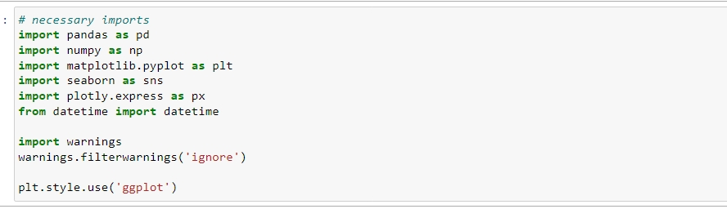
Python Implementation
Here we will see various models that can be used for insurance fraud detection and their accuracy.
Importing Libraries

Slide 5
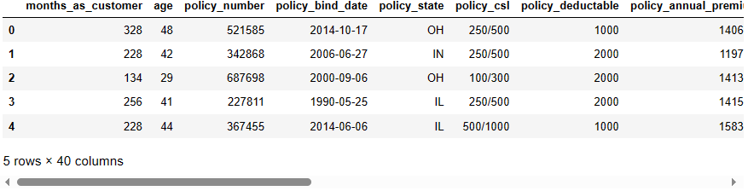
Data description
The dataset contains 40 columns.

Slide 6
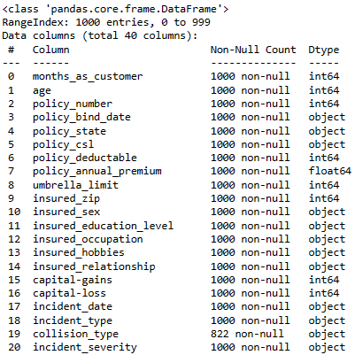
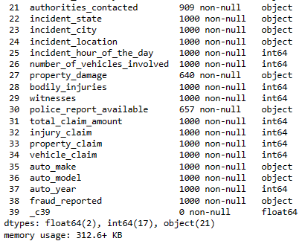
Information of Dataset

Slide 7
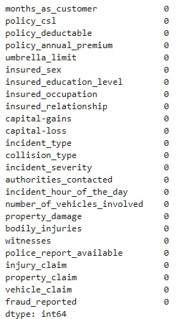
Preprocessing missing values

Slide 8
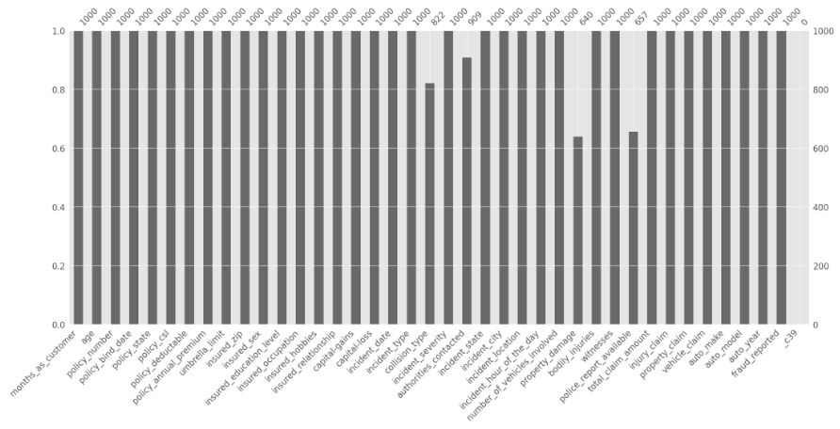
Visualizing Missing Values
Missing values can be problematic for machine learning models as they may result in biased or inaccurate results. So visualizing them would help in understanding the extent and pattern of missing data.

Slide 9
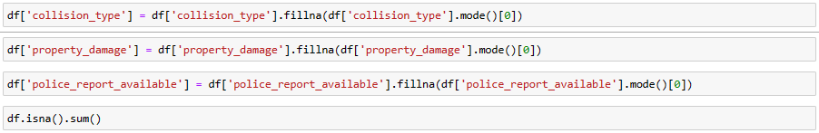
Handling Missing Value
We will handle the missing value as we will allocate 0 to the missing values as a substitute.
Now, there is no missing
value in our data.

Slide 10
Outliers Detection
Data points known as outliers differ dramatically from other data points in a dataset. Outliers can appear for a number of reasons, including measurement mistakes, data input problems, or inherent data variability. Statistical analysis and machine learning models can be significantly impacted by outliers because they might provide estimates that are skewed or forecasts that are incorrect.
We will try to look out for the outliers in our data.

Slide 11
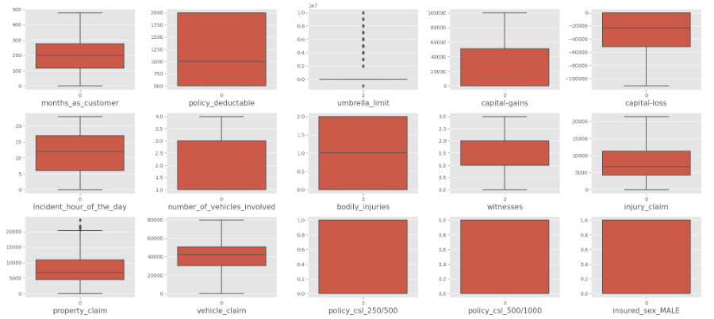
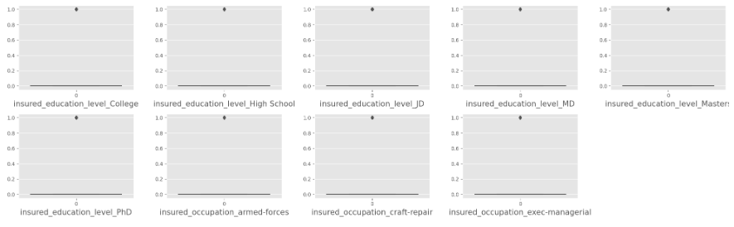

Slide 12
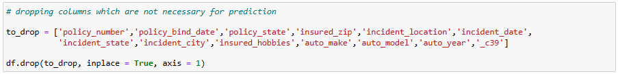
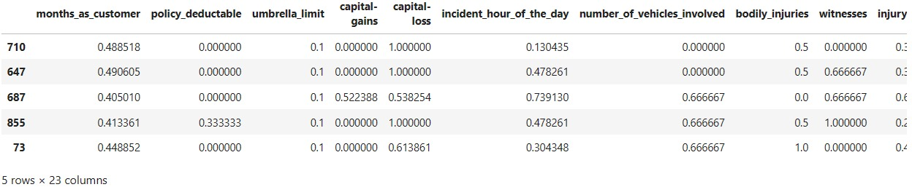
Dropping Unnecessary Columns

Slide 13
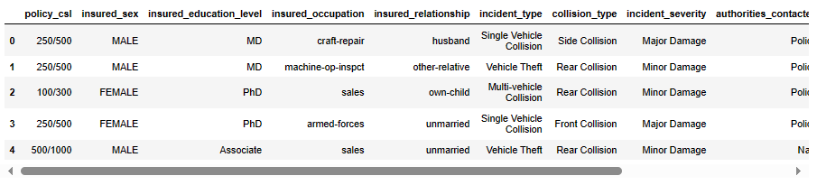
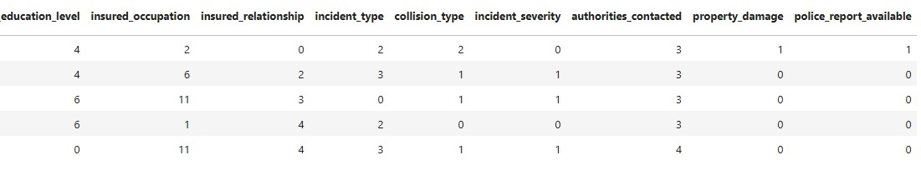
Encoding Categorical Variable.
It involves converting categorical data into numerical data that can be processed by machine learning models.
We will encode categorical variables into numerical data so that our model will have the ease to predict insurance fraud.

Slide 14
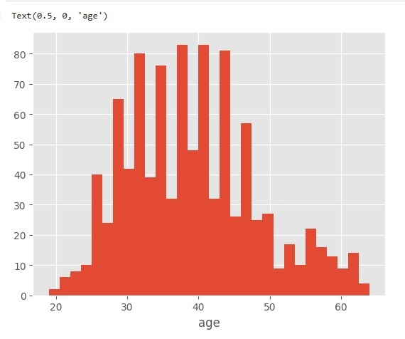
Exploratory Data Analysis
Univariate:

Slide 15
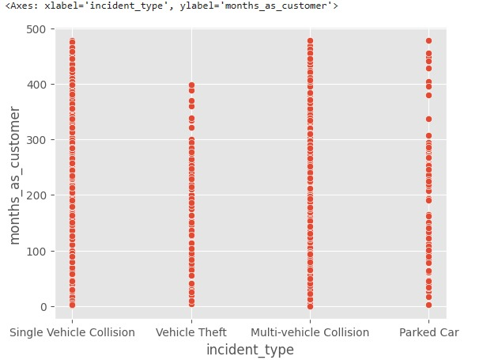
Bivarite:

Slide 16
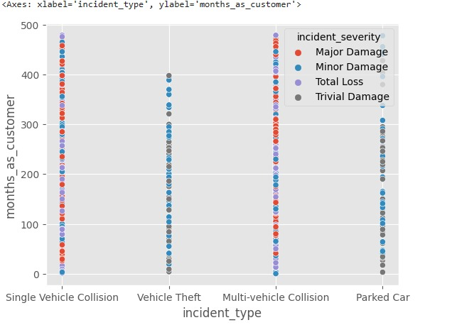
Multivariate:

Slide 17
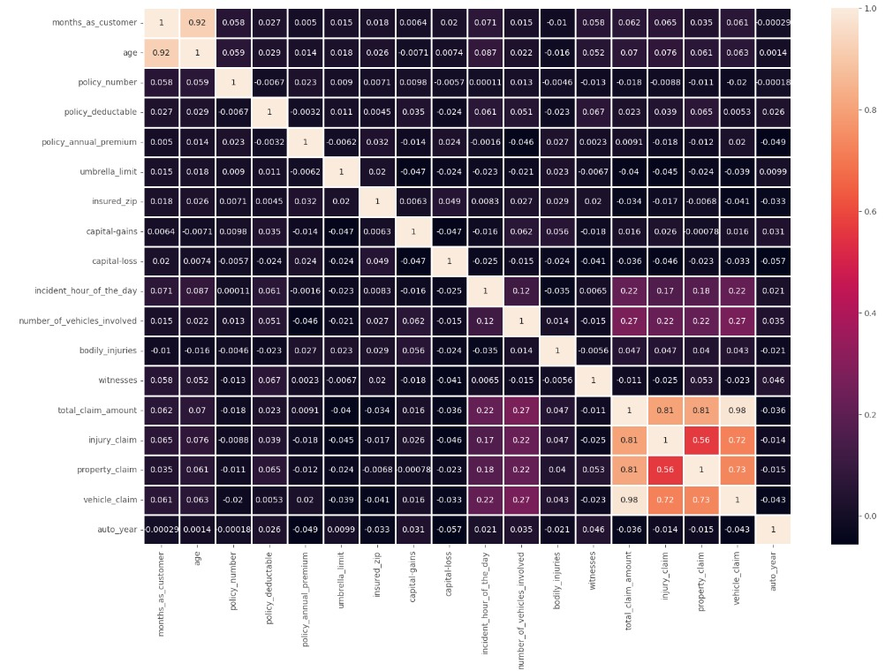
Correlation Heatmap
From the below plot, we can see that there is a high correlation between age and months_as_customer. We will drop the "Age" column. Also, there is a high correlation between total_clam_amount, injury_claim, property_claim, and vehicle_claim, as the total claim is the sum of all others. So we will drop the total claim column.

Slide 18
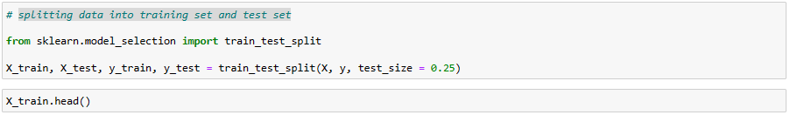
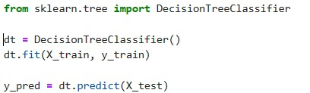
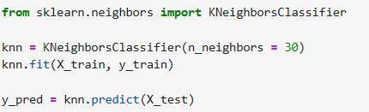
Model building

Slide 19
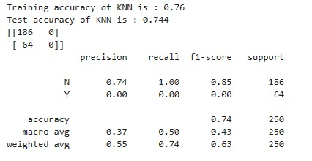

Accuracy_score, confusion_matrix and classification_report
This will check on the accuracy of the models.

Slide 20

Visualizing the model comparison.

Slide 21
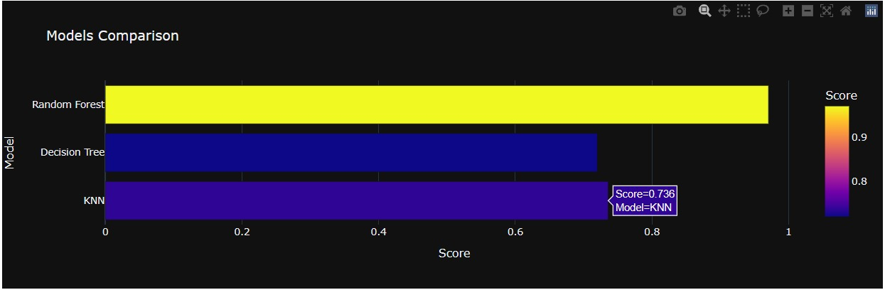

Slide 22
Result
MODEL | ACCURACY
Random Forest | 96.2%
Decision Tree classifier | 78.0%
KNN | 74.4%

Slide 23
Conclusion
Insurance fraud is a severe issue that can negatively affect insurance providers and their clients. By locating patterns and abnormalities in the data, machine learning algorithms may be utilized to detect and stop fraud. To guarantee the accuracy and efficiency of the model, it is crucial to select the appropriate method and manage the unbalanced nature of the data.
Keep that in mind; we need to be very selective while opting for the model, as it will have a greater impact on the prediction.
Future scope
The future scope involves further enhancing the model's performance and robustness by exploring advanced ensemble techniques, deep learning architectures, and anomaly detection algorithms. Additionally, integrating advanced feature engineering techniques, leveraging unstructured data sources such as text and images, and implementing real-time monitoring and feedback mechanisms to adapt to evolving fraud patterns will be pursued. Collaboration with domain experts, continuous model refinement, and scalability considerations for deployment in larger insurance ecosystems will also be prioritized.

Slide 24
Thank you

